Slide 1
Hurricane Harvey – One year later. How is Houston Making Its Disaster Planning Disability Inclusive?
Maria Town
Director
Mayor’s Office for People with Disabilities
City of Houston

Slide 2
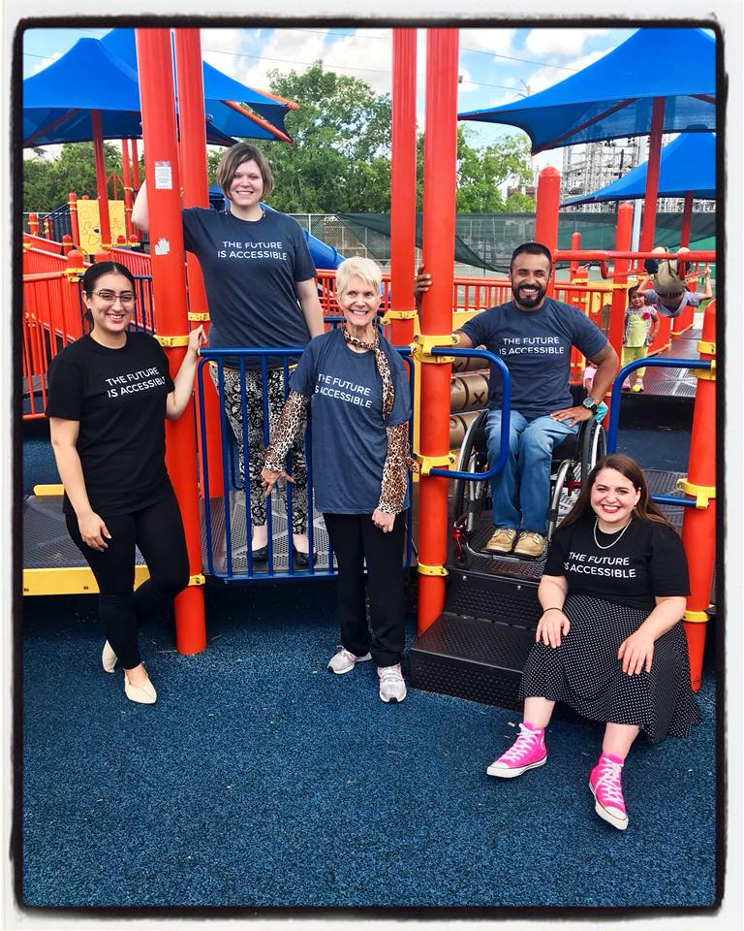
Introduction: Mayor’s Office for People with Disabilities
Who We Are
Established in 1993.
Serve as the primary advocate for the rights and needs of citizens with disabilities.
Serves as a liaison between the mayor, city council, city departments and other public and private entities on matters pertaining to people with disabilities in Houston.
Works closely with the Houston Commission on Disabilities.

Slide 3
Introduction: Mayor’s Office for People with Disabilities
What We Do
Trainings and awareness programs
Sidewalk fixes
Free visual fire alarms
Provide free legal clinics for people with disabilities
Employment services
Case management
Policy and program recommendations to the Mayor, city and state leaders and private entities
Work closely with the Houston Commission on Disabilities

Slide 4
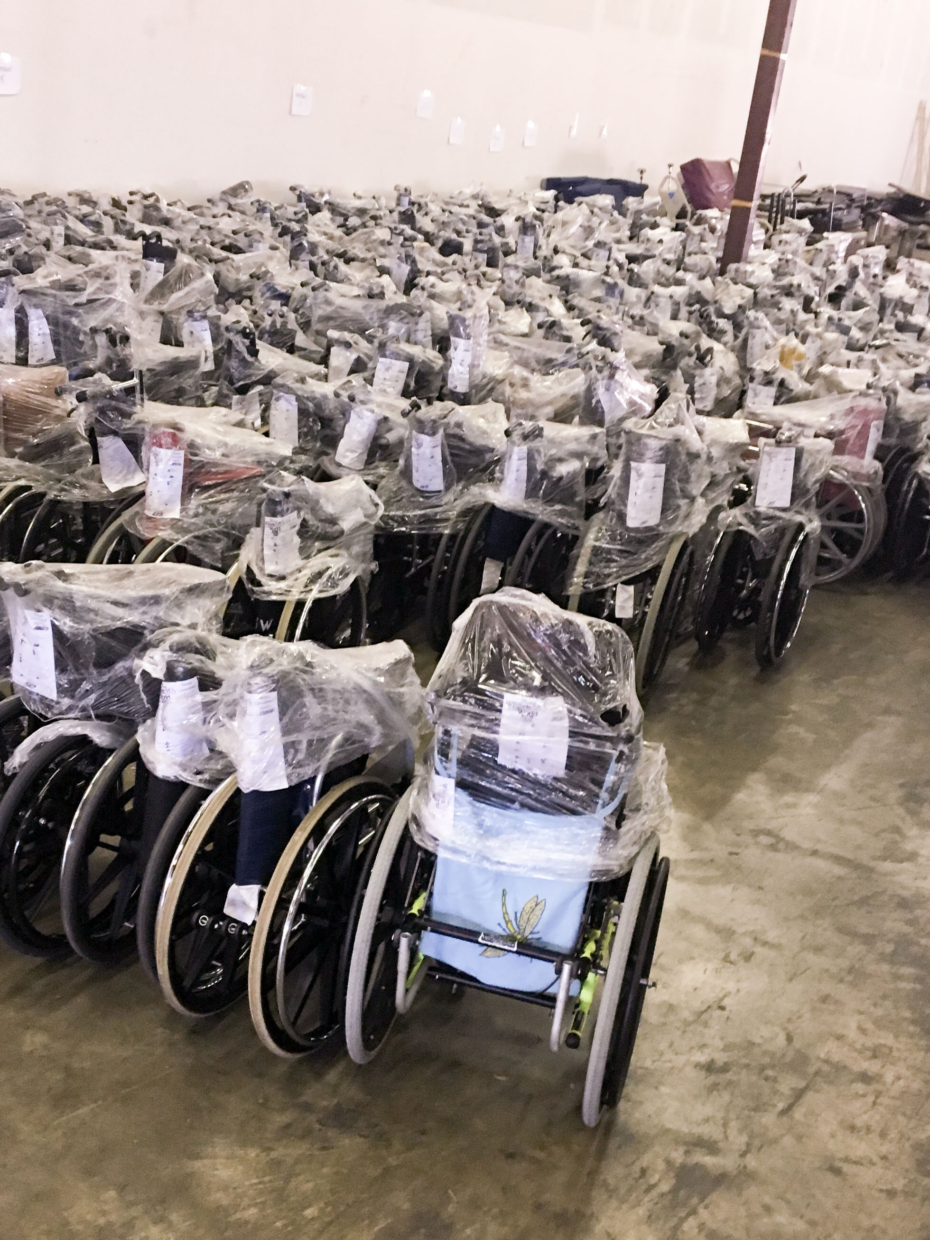
Role During Harvey
Community Coordination
Durable Medical Equipment Replacement
Information Sharing
Liaising with Emergency Responders and City, State and Federal Departments
Shelter Resources
Advocacy on Behalf of Individuals and Communities
Notes:
Largest Natural Disaster in State History
The Harvey 4-day rainfall total for the Houston region was 47.7 inches – compared to 38.5 inches during Hurricane Allison and the 2-day total of 17.5 inches during the 2016 Tax Day flood.
Hurricane Harvey dumped enough rain on Harris County to fill the Astrodome 3,200 times, or to run Niagara Falls for 15 days. 13 of the 22 watersheds in Harris County reached record levels. Over 60,000 people in our region were rescued during the storm.
Beyond the physical damage, we must also think about the more hidden impacts of the storm – including emotional and mental health, job loss, financial instability and others.
Harvey was a Category 4 Hurricane that made landfall on August 25, 2017.
The storm was one of the longest-lasting hurricane events in the history of the US, forming on August 17 and dissipating on September 1st, affecting SE Texas and SW Louisiana.
Maximum Rainfall: 62 inches (most in US history)
Maximum Wind Speed: 130 mph
Recorded Tornadoes: 57
Fatalities: 107 (directly and indirectly)
Economic Damage: $125 billion (2nd costliest in US history)
565,043 businesses affected
25 percent of area's oil production was down (5 percent of total US production)
Residential Damage: 190,300 homes damaged, 12,700 destroyed
Vehicle Damage: 1 million ruined beyond repair

Slide 5
Realities A Year After Harvey
$4.29 billion have been distributed directly from the federal government to affected residents.
26,400 Houstonians filed Flood Insurance claims;
136,122 approved registrations for FEMA Individual Assistance claims.
28,957 Individual assistance registrations with identified access and functional needs,
The City of Houston data analysis shows that 169,000 residential buildings in Houston were affected, accounting for 317,000 households.
The City of Houston has still not received any Community Development Block Grant Disaster Recovery dollars.

Slide 6
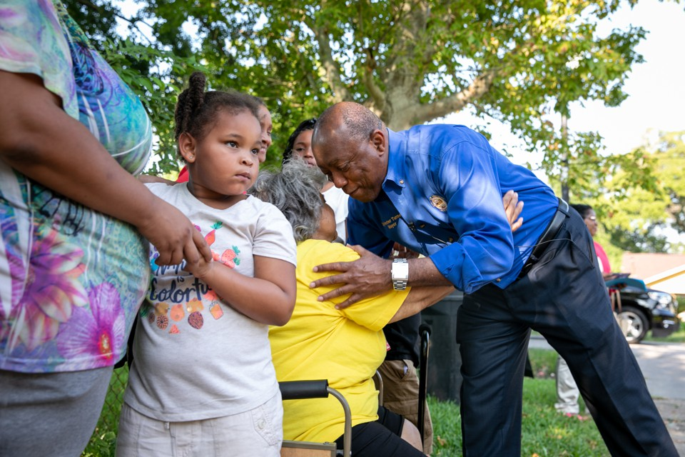
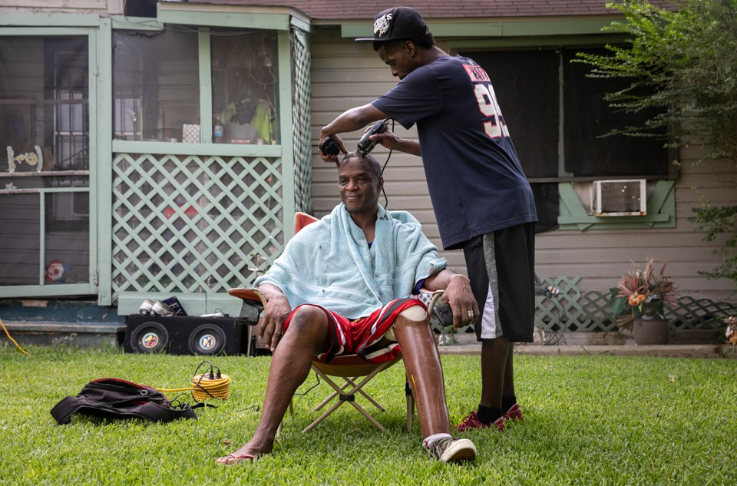
Realities A Year After Harvey
City of Houston and Harris County voters approved a $2.5 billion flood bond.
The City of Houston has established 14 Neighborhood resiliency centers.
Community organizations continue to lead through the Long Term Recovery Committee.
Harvey was equal opportunity in its destruction, but not in its aftermath.
Houston is navigating Harvey recovery while continuing to recover from previous disasters.

Slide 7
A Seat at the Tables
The MOPD is now a part of the City of Houston’s Recovery Leadership Team and a part of the State of Texas’ Division of Emergency Management Disabilities Planning Subcommittee.
Houston Commission on Disabilities Committee on Disaster Preparedness and Emergency Response now connected to the Office of Emergency Management, Public Works, and Housing Departments.
Housing Department engagement of the disability community on Texas General Land Office Action Plans and beyond.
The MOPD has convened disability-specific groups for community driven recommendations for inclusive preparedness.

Slide 8
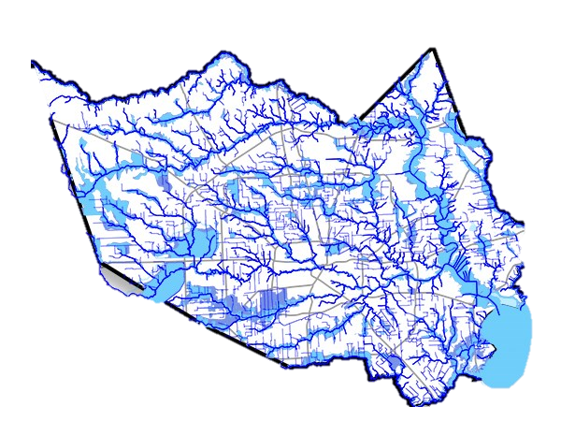
City Repair Requirements for Public and Private Construction
Harvey created an opportunity for Houston to become more inclusive during and beyond times of disasters.
Houston Public Works developed an accessibility requirement for all public and private construction projects of $50,000 or more.
Potential visitability requirements for CDBG-DR funded rebuilding programs, which could pave the way for a visitability ordinance for the city.

Slide 9
Emergency Registries
Currently, the City of Houston can access the State of Texas Emergency Assistance Registry.
Only a few individuals were contacted using STEAR.
“I don’t understand. I was registered and no one come.”
The City is exploring and developing new tools and protocols to contact people with disabilities during disasters.

Slide 10
Continued Advocacy
Houston Commission on Disabilities Letter to the Recovery Leadership Team and other recovery partners.
Houston hosted a FEMA listening session on the experiences of individuals with disabilities.
Continued advocacy at the Federal and State level for funding, community driven solutions, and changes to FEMA.

Slide 11
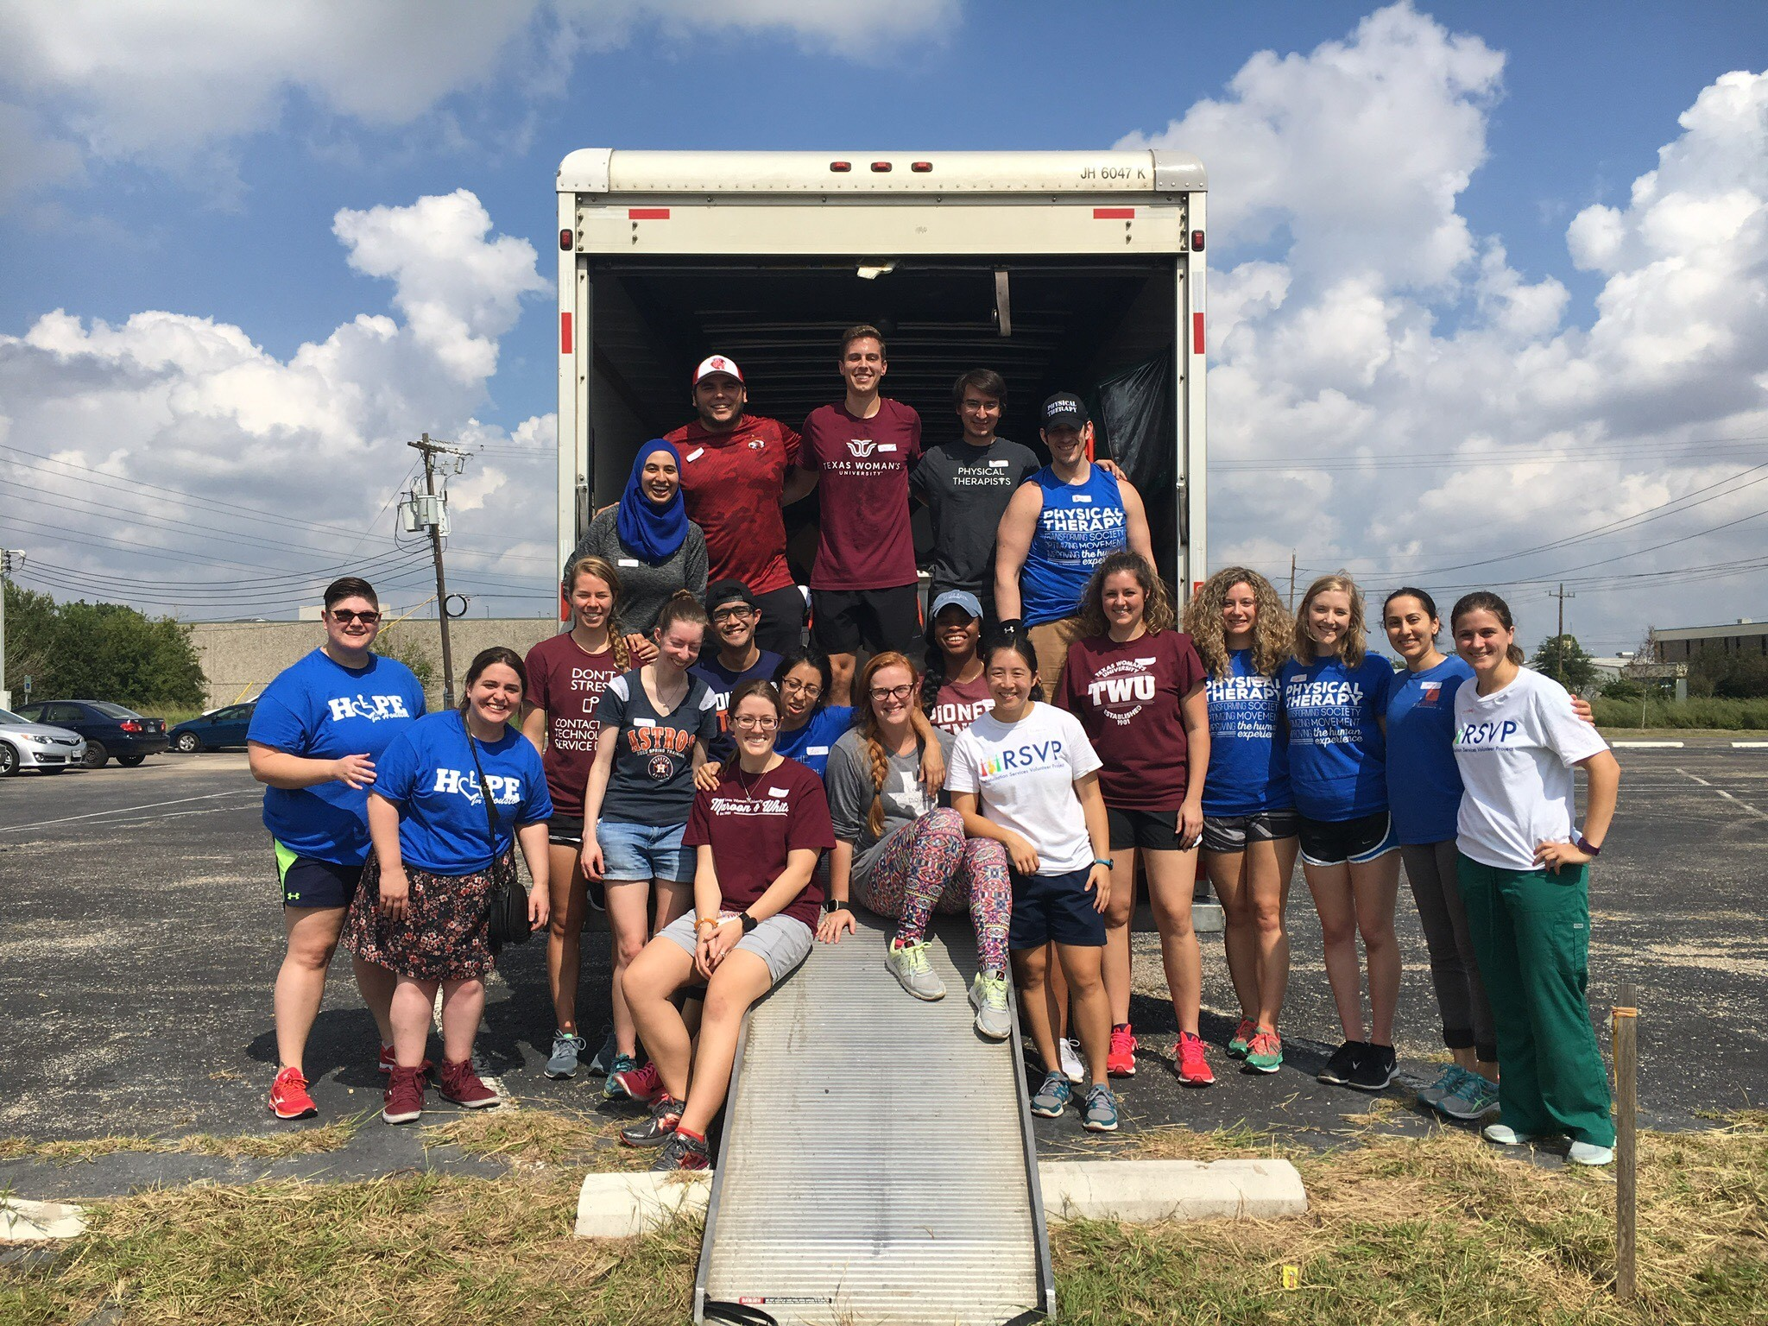
Support of Sister Cities
Working with the Puerto Rican protection and advocacy provider, equipment was distributed across the island.
Working with community groups, the MOPD shipped durable medical equipment and consumable medical supplies to Puerto Rico.

Slide 12
Maintaining An Inventory
Since Harvey, the MOPD has worked to develop and maintain an inventory of some durable medical equipment that can be distributed to individuals and organizations during emergencies.
Considerations for inventories:
Location and Frequency of Disasters
Local population needs
Expiration dates
Climate control

Slide 13
Building Relationships
The Mayor’s Office for People with Disabilities is the only MOPD in the state of Texas.
Since Harvey, the MOPD has worked to establish relationships with:
Emergency management and response entities across the affected region.
Local and national non-profit and philanthropic partners
Internal City of Houston Partners

Slide 14
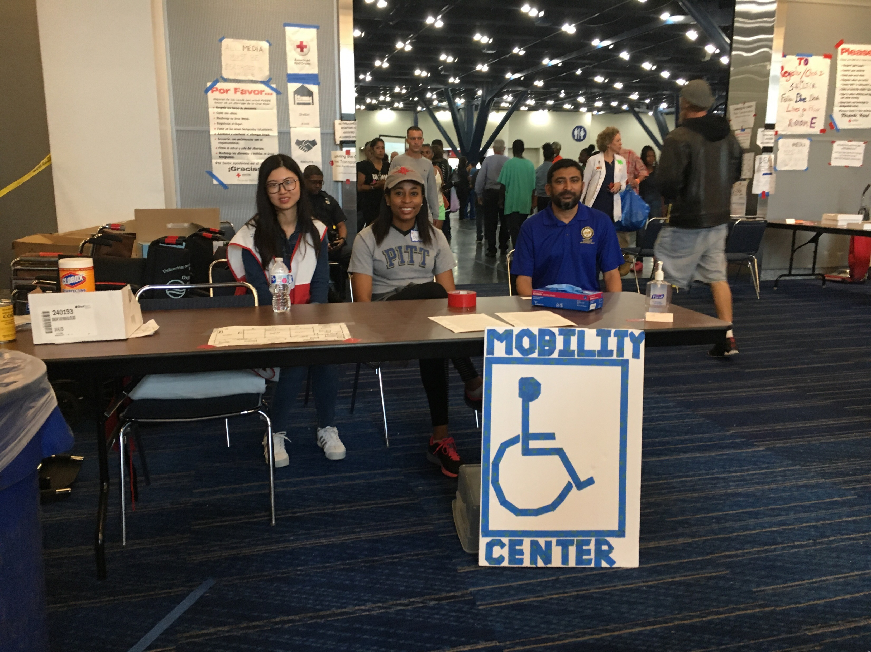
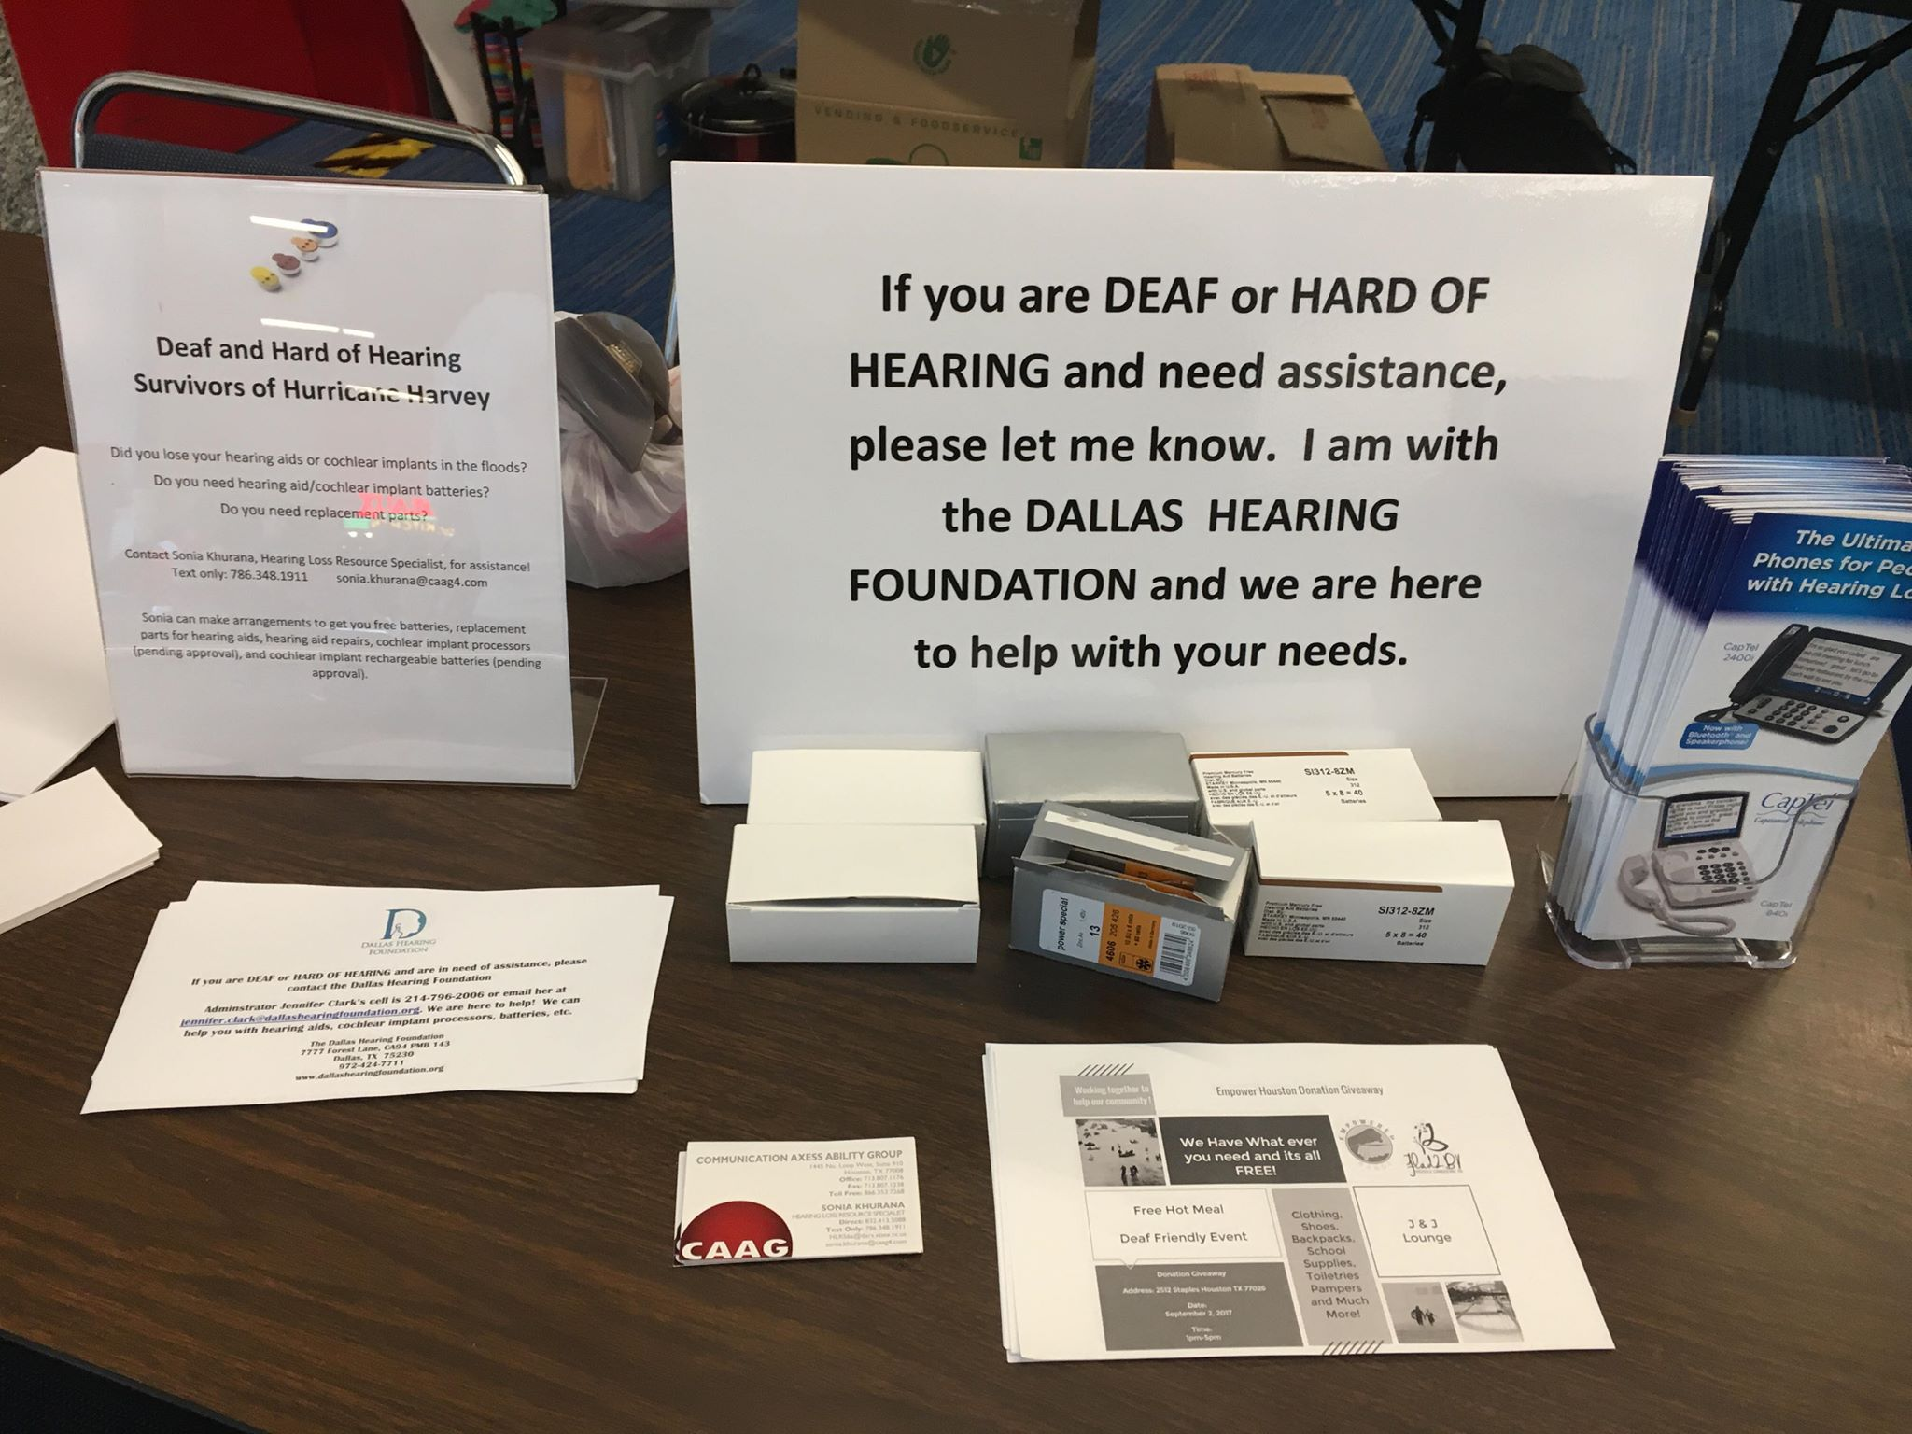
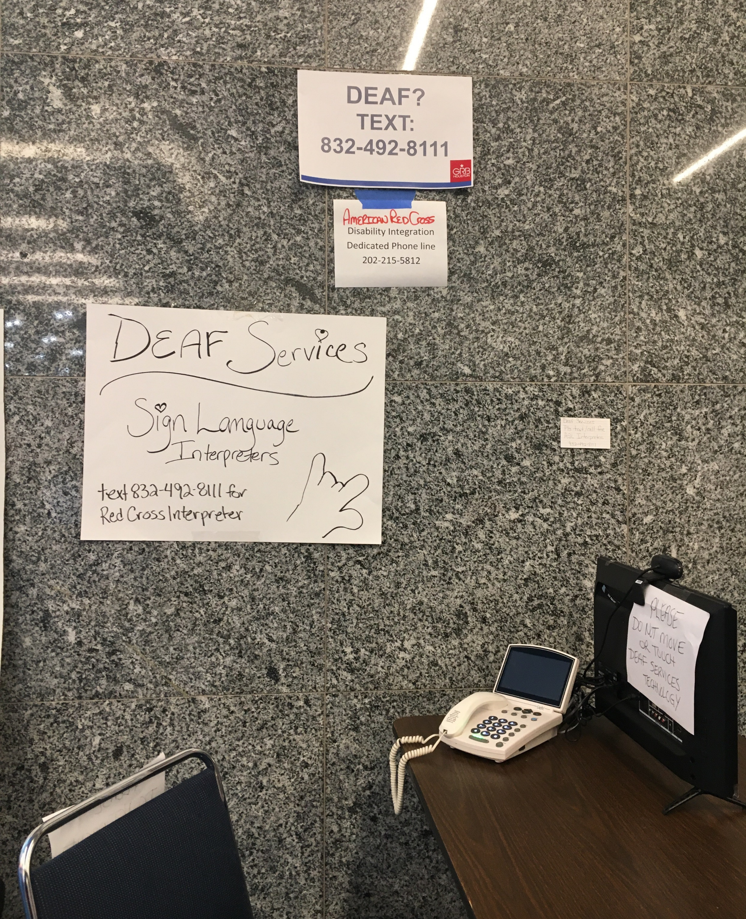
Expanding Capacity
Emergency responder and emergency management training on disability competency & disability rights
Shelter management improvements around accessibility protocols.
American Sign Language emergency alerts and ASL fluent 911 responder.

Slide 15
Expanding Capacity
CERT Training
The City’s Department of Homeland Security has expanded their CERT training and is building out CERT training for the blind community and a cross-disability community CERT training.
This builds on the existing deaf CERT trained community in Houston.
Shelter Exercises
Direct and intentional engagement of the disability community to “break” the shelter exercise and develop ideas for solutions.

Slide 16
Memorializing Policy and Process
During Harvey, questions came up around inclusive education services and voting rights of individuals.
There were additional questions concerning organizations’ ability to replace iPads and protocol around durable medical equipment loans.

Slide 17
Resources
Centers for Disease Control – Emergency Preparedness: Including People with Disabilities - https://www.cdc.gov/ncbddd/disabilityandhealth/emergencypreparedness.html
Ready.gov – Individuals with Access and Functional Needs https://www.ready.gov/individuals-access-functional-needs
Red Cross – Disaster Safety for People with Disabilities https://www.redcross.org/get-help/how-to-prepare-for-emergencies/disaster-safety-for-people-with-disabilities.html
FEMA – Accessible Emergency Management https://www.redcross.org/get-help/how-to-prepare-for-emergencies/disaster-safety-for-people-with-disabilities.html

Slide 18
Resources
The Partnership for Inclusive Disaster Strategies – Integrating Disability Into Emergency Management: A Blue Print for Saving Lives http://disasterstrategies.org/application/files/2315/3229/1809/Integrating_Disability_Into_Emergency_Management24426.compressed.pdf
The Partnership for Inclusive Disaster Strategies – 2017/2018 After Action Report – Getting It Wrong: An Indictment with a Blueprint for Getting It Right http://www.disasterstrategies.org/index.php/news/partnership-releases-2017-2018-after-action-report
Texans for Special Education Reform – Special Education Guidance for Families of Children with Disabilities Affected by Hurricane Harvey https://www.texans4spedreform.org/hurricane/
Disability Rights Texas – Housing Rights Information for People with Disabilities Impacted by Hurricane Harvey https://www.disabilityrightstx.org/publication/housing-rights-information-for-people-with-disabilities-impacted-by-hurricane-harvey

Slide 19
Questions
Maria Town
Mayor’s Office for People with Disabilities
832-394-0814
mopdmail@houstontx.gov
Facebook: https://www.facebook.com/
HoustonMOPD
Twitter: @MOPD_Houston

